Slide 1
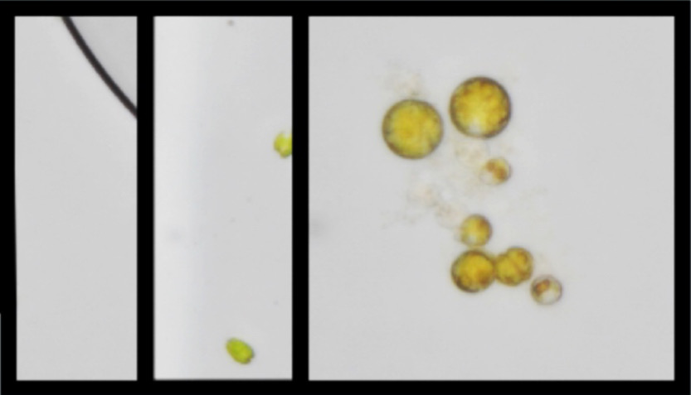
Data
Augmentation
Mosaic
TPH
Ground Truth
MixUP
Localization
photometric distortion
Classification
TPH
ms-testing
scale
TPH
Self-trained Classifier
horizental filp
Model Ensemble
Prediction
NMS
Localization
Mosaic
TPH
ResNet18
WBF
Classification

Slide 2
Data
Augmentation
Mosaic
TPH
Ground Truth
MixUP
Localization
Training
photometric distortion
Classification
TPH
ms-testing
scale
TPH
horizental filp
Model Ensemble
Prediction
NMS
Localization
Mosaic
TPH
WBF
Classification

Slide 3
Data
Augmentation
Mosaic
TPH
Ground Truth
MixUP
Localization
Training
photometric distortion
Classification
TPH
ms-testing
scale
TPH
horizental filp
Model Ensemble
Prediction
NMS
Localization
Mosaic
TPH
WBF
Classification

Slide 4
Label
Label Encoding
One-Hot Encoding
666
0
[1, 0, 0, 0, 0]
Good
1
[0, 1, 0, 0, 0]
Hello
2
[0, 0, 1, 0, 0]
Thanks
3
[0, 0, 0, 1, 0]
Yeah
4
[0, 0, 0, 0, 1]

Slide 5
Data
Augmentation
Mosaic
Ground Truth
Localization
MixUP
Training
photometric distortion
Classification
EfficientNet
PANet
Output
ms-testing
scale
Prediction
horizental filp
Model Ensemble
Localization
Mosaic
NMS
Classification
CSPDark-Net53
PANet
Output

Slide 6
Data
Augmentation
Mosaic
Ground Truth
Localization
MixUP
Training
Copy Paste
Classification
EfficientNet
PANet
Output
ms-testing
Scale
Prediction
Horizental filp
Model Ensemble
Localization
NMS
Mosaic
Classification
CSPDark-Net53
PANet
Output

Slide 7
Data
Augmentation
EfficientNet-YOLOv5
Mosaic
Ground Truth
Localization
MixUP
Training
Copy Paste
Classification
EfficientNet
PANet
Output
mm-testing
YOLOv5s
Scale
Prediction
Model Ensemble
Localization
Horizental filp
NMS
Classification
CSPDarkNet53
PANet
Output

Slide 8
Neck
CBAM
TPH
Backbone
TPH
1
Trans
Conv
Focus
Concat
Conv
Upsample
Conv
3 * C3
CBAM
Conv
Concat
Conv
3 * C3
Trans
Conv
TPH
2
9 * C3
Concat
CBAM
Conv
Conv
CBAM
Upsample
Concat
9 * C3
3 * C3
Conv
TPH
3
2 * Trans
Conv
Conv
Concat
CBAM
SPP
Upsample
Conv
3 * Trans
Conv
Concat
TPH
4
3 * Trans
Conv

Slide 9
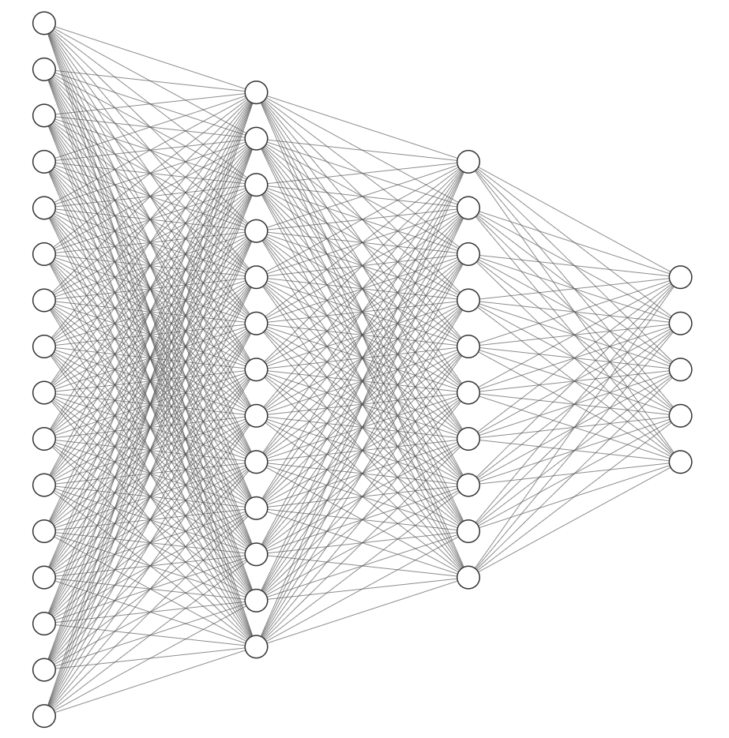
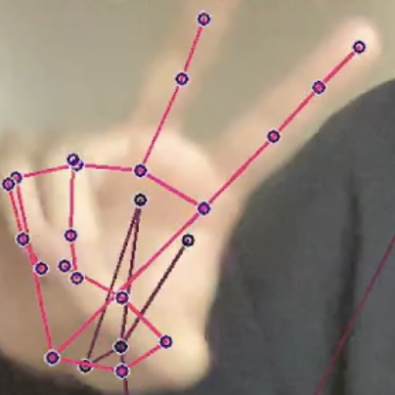
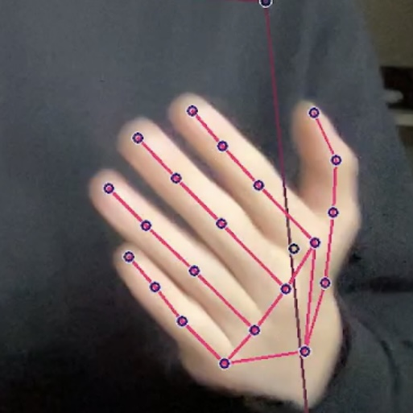
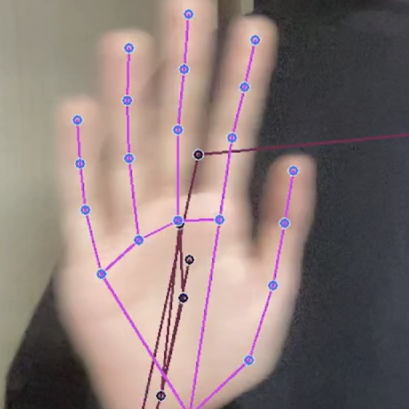
Non-Maximum
Suppression
LSTM(64, ‘relu’)
Image
EfficientNet
ResNet50 or Classification Model
Yeah
Good
LSTM(64, ‘relu’, input)
LSTM(128, ‘relu’)
LSTM(64, ‘relu’)
Fully Connected Layer
Thanks
Hello
666(Awesome)

Slide 10
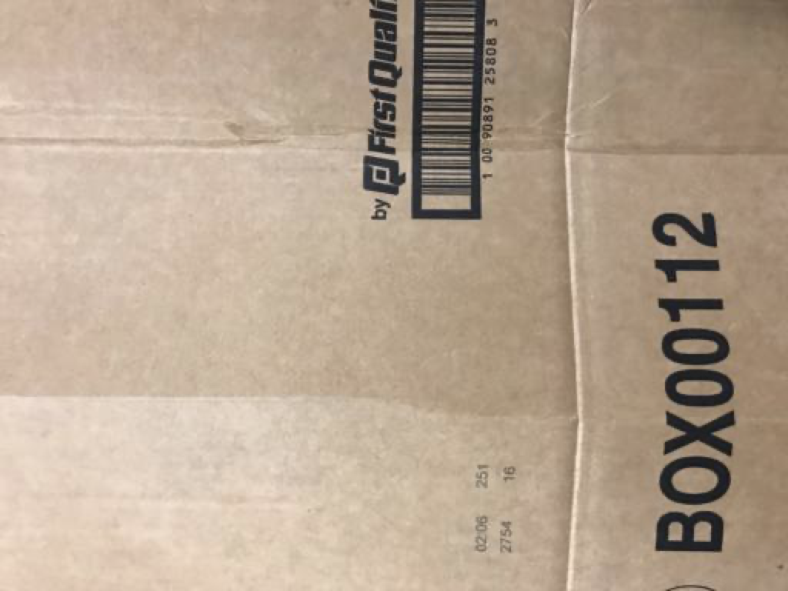
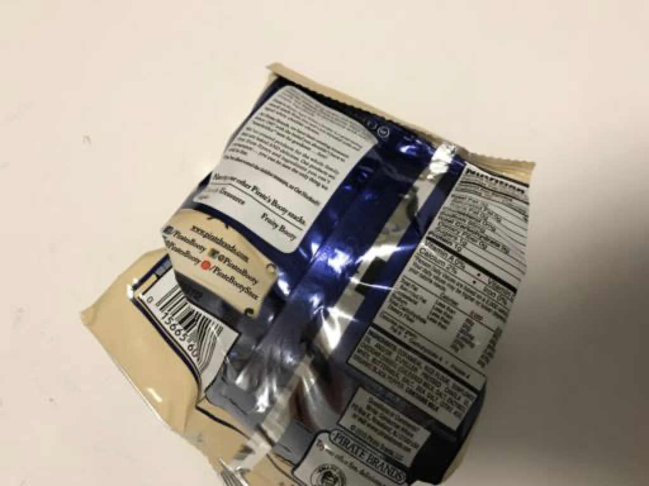


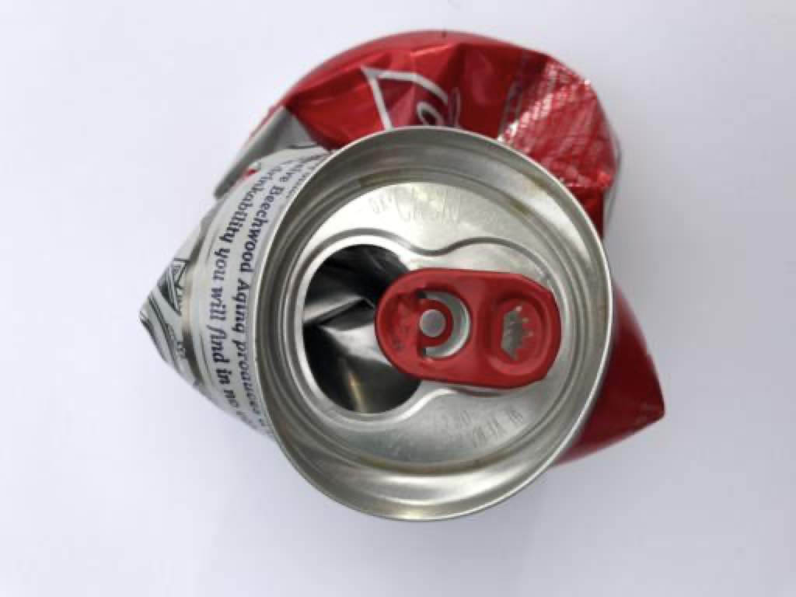
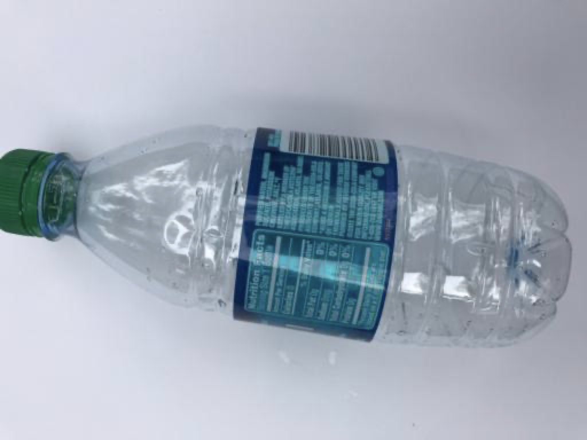
Conv
BatchNormalization
Activation
conv_block
Avg_Pool
softmax
identity_block
LSTM-softmax

Slide 11
focus
Dwise
Separable
Conv5
Dwise3×3
+
RELU6
Conv1×1
Conv1×1
+
RELU6
Dwise3×3
＋
SimAM

Slide 12
focus
Dwise
Separable
Conv5
Dwise3×3
+
RELU6
Conv1×1
Conv1×1
+
RELU6
Dwise3×3
＋
SimAM

Slide 13
SiLU
ReLU6
plastic
paper
paper
Global
Pool
+
FC
Conv
Dwise
3×3
Dwise
3×3
Dwise
3×3
Dwise
3×3
Conv5
metal
Training dataset
Focus
Stage1
Stage2
Stage3
Stage4
Classifer
cardboard
trash

Slide 14
plastic
paper
paper
Global
Pool
+
FC
Conv
Dwise
3×3
Dwise
3×3
Dwise
3×3
Dwise
3×3
Conv5
metal
Training dataset
Focus
Stage1
Stage2
Stage3
Stage4
Classifer
cardboard
trash

Slide 15
plastic
paper
paper
Global
Pool
+
FC
Conv
Dwise
3×3
Dwise
3×3
Dwise
3×3
Dwise
3×3
Conv5
metal
Training dataset
Focus
Stage1
Stage2
Stage3
Stage4
Classifer
cardboard
trash

Slide 16

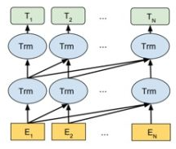

cMedQA
cMedQA2
Fine-Tuning
LLM
问：气虚有哪些症状？可以怎么治疗？
LoRA
cMedQA-merged
ChatGLM-6B
答：你好，根据你的描述，考虑是气虚的表现，可以服用一些益气固表的中成药，如参苓白术散，玉屏风颗粒等。同时注意饮食，多吃粗粮，多吃蔬菜，少吃油腻，多喝水，保持心情愉悦。
Hello, according to your description, it is considered to be a manifestation of Qi deficiency. You can take some Chinese medicines that benefit Qi and fix the surface, such as Radix et Rhizoma Ginseng and Rhizoma Atractylodis Macrocephalae, Yu Ping Feng Granules, etc. Also pay attention to your diet, eat more coarse grains, more vegetables, less greasy food, drink more water and keep your mood happy.
Freeze
Q: "如何治疗带状疱疹后遗症皮肤发痒？"
A: "西医学对带状疱疹的治疗原则为抗病毒、消炎止痛和防止继发感染。抗病毒药有阿糖腺苷、无环鸟苷及干扰素等。消炎止痛药如阿斯匹林、维生素B1、维生素B12等。局部患处可用2%龙胆紫溶液或复方地榆氧化锌油（生地榆10g，紫草5g，冰片2g，氧化锌油加到100g）外涂。若有继发感染，可用新霉素软膏外搽。"
.....
P-Tuning V2
Reinforcement Learning
RLHF
PPO

Slide 17
Conv
BatchNormalization
Activation
conv_block
Avg_Pool
softmax
identity_block
LSTM-softmax

Slide 18
Conv
Conv
Conv
VGG16
Classifier
Detection
Classifier
Non-Maximum suppression
Conv
Conv
Conv
Conv
Conv
Conv

Slide 19
Neck
CBAM
TPH
Backbone
TPH
1
Trans
Conv
EfficientNet
Concat
Upsample
Conv
CBAM
Conv
Concat
3 * C3
Trans
Conv
TPH
2
EfficientNet
Concat
CBAM
Conv
CBAM
Upsample
Concat
EfficientNet
3 * C3
Conv
TPH
3
2 * Trans
Conv
Concat
CBAM
Upsample
Conv
3 * Trans
Conv
Concat
TPH
4
3 * Trans
Conv

Slide 20
Backbone
Neck
Head
EfficientNet
Conv
Concat
EfficientNet
3 * C3
3 * C3
Conv
Concat
Conv
Upsample
Concat
EfficientNet
3 * C3
Conv
3 * C3
Conv
Concat
Upsample
Conv
SPPF
Conv
Concat
Conv
3 * C3

Slide 21
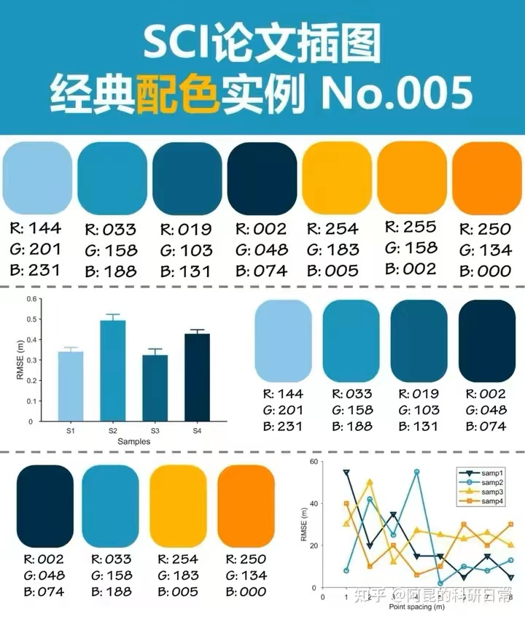
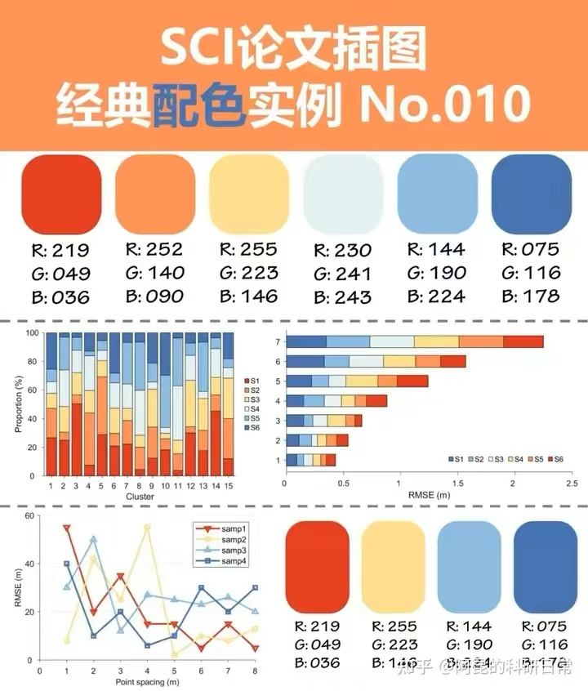
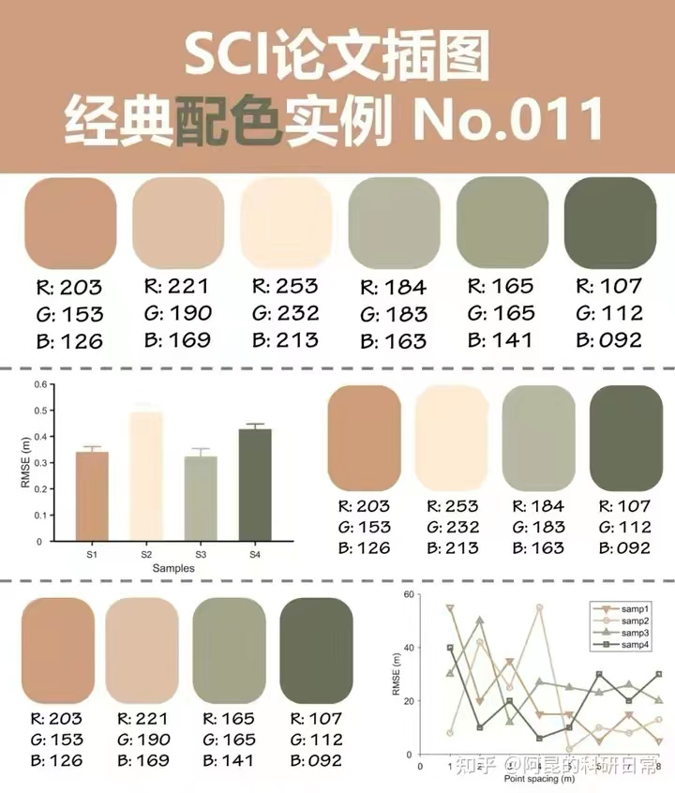
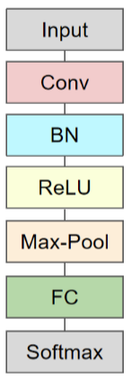
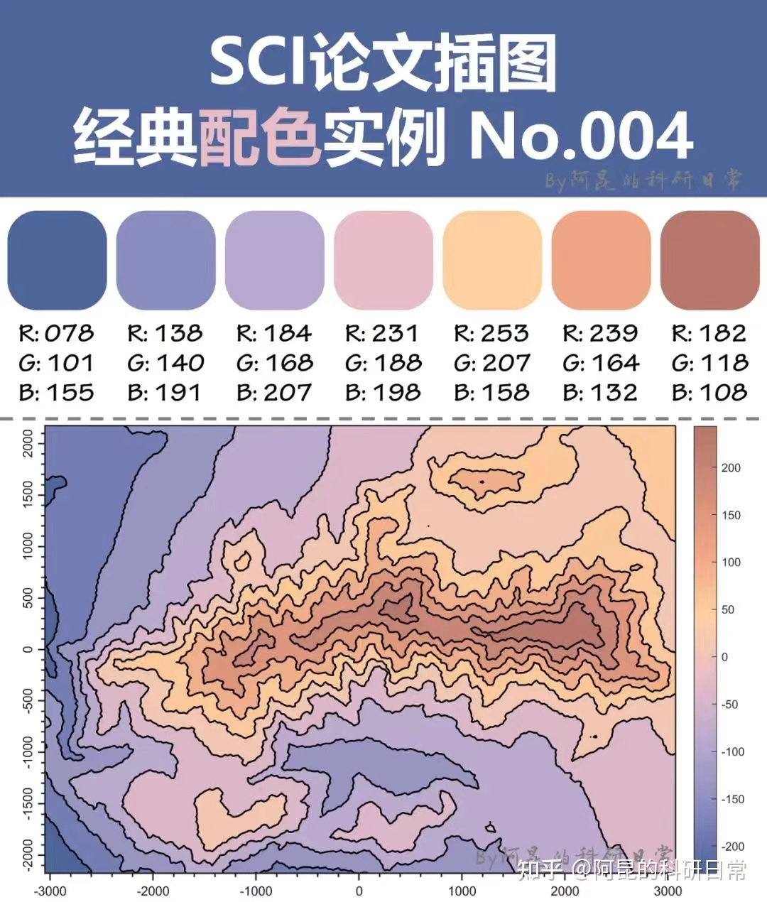

Softmax
Linear
Add & Norm
Feed
Forward
Add & Norm
Add & Norm
Feed
Forward
Multi-Head
Attention
Add & Norm
Add & Norm
Multi-Head
Attention
Masked
Multi-Head
Attention
Positional
Encoding
Positional
Encoding
Input
Embedding
Output
Embedding
Inputs
Outputs
(shifted right)

Slide 22
abc
abc
abc
abcd
abc
abc

Slide 23
Softmax
Linear
Add & Norm
Feed
Forward
Add & Norm
Add & Norm
Feed
Forward
Multi-Head
Attention
Add & Norm
Add & Norm
Multi-Head
Attention
Masked
Multi-Head
Attention
Positional
Encoding
Positional
Encoding
Input
Embedding
Output
Embedding
Inputs
Outputs
(shifted right)

Slide 24
Output
Probabilities
Softmax
Linear
Add & Norm
Feed
Forward
Add & Norm
Add & Norm
Feed
Forward
Multi-Head
Attention
Add & Norm
Add & Norm
Multi-Head
Attention
Masked
Multi-Head
Attention
Positional
Encoding
Positional
Encoding
Input
Embedding
Output
Embedding
Inputs
Outputs
(shifted right)

Slide 25

Output
Probabilities
Softmax
Multi-head attention
Linear
Add & Norm
Linear
Feed
Forward
Concat
Add & Norm
Add & Norm
Feed
Forward
Multi-Head
Attention
Scaled Dot-Product
Attention
h
Add & Norm
Add & Norm
Linear
Linear
Linear
Multi-Head
Attention
Masked
Multi-Head
Attention
V
K
Q
Positional
Encoding
Positional
Encoding
Input
Embedding
Output
Embedding
Inputs
Outputs
(shifted right)

Slide 26
Output
Probabilities
Softmax
Multi-head attention
Linear
Add & Norm
Linear
Feed
Forward
Scaled dot-product attention
Concat
Add & Norm
Add & Norm
Feed
Forward
Multi-Head
Attention
MatMul
Scaled Dot-Product
Attention
h
SoftMax
Add & Norm
Add & Norm
Linear
Linear
Linear
Multi-Head
Attention
Masked
Multi-Head
Attention
Mask (opt.)
Scale
V
K
Q
Positional
Encoding
Positional
Encoding
MatMul
Input
Embedding
Output
Embedding
V
K
Q
Inputs
Outputs
(shifted right)

Slide 27
Transformer-Encoder
Transformer-Decoder
Output
Probabilities
Softmax
Multi-head attention
Linear
Linear
Add & Norm
Feed
Forward
Scaled dot-product attention
Concat
Add & Norm
Feed
Forward
Add & Norm
MatMul
Scaled Dot-Product
Attention
h
Multi-Head
Attention
SoftMax
Add & Norm
Add & Norm
Linear
Linear
Linear
Multi-Head
Attention
Masked
Multi-Head
Attention
Mask (opt.)
Scale
V
K
Q
Positional
Encoding
Positional
Encoding
MatMul
Input
Embedding
Output
Embedding
V
K
Q
Inputs
Outputs
(shifted right)

Slide 28
Transformer-Encoder
Transformer-Decoder
Output
Probabilities
Softmax
Multi-head attention
Linear
Linear
Add & Norm
Feed
Forward
Scaled dot-product attention
Concat
Add & Norm
Feed
Forward
Add & Norm
MatMul
Scaled Dot-Product
Attention
h
Multi-Head
Attention
SoftMax
Add & Norm
Add & Norm
Linear
Linear
Linear
Multi-Head
Attention
Masked
Multi-Head
Attention
Mask (opt.)
Scale
V
K
Q
Positional
Encoding
Positional
Encoding
MatMul
Input
Embedding
Output
Embedding
V
K
Q
Inputs
Outputs
(shifted right)

Slide 29
Transformer-Encoder
Output
Probabilities
Softmax
Linear
Add & Norm
Feed
Forward
Add & Norm
Add & Norm
Feed
Forward
Multi-Head
Attention
Add & Norm
Add & Norm
Multi-Head
Attention
Masked
Multi-Head
Attention
Positional
Encoding
Positional
Encoding
Input
Embedding
Output
Embedding
Inputs
Outputs
(shifted right)

Slide 30
Softmax
Linear
Add & Norm
Feed
Forward
Add & Norm
Add & Norm
Feed
Forward
Multi-Head
Attention
Add & Norm
Add & Norm
Multi-Head
Attention
Masked
Multi-Head
Attention
Positional
Encoding
Positional
Encoding
Input
Embedding
Output
Embedding
Inputs
Outputs
(shifted right)
Notes:
Note:
Using the same visual components from before and a few new custom ones, I was able to come up with the Transformer architecture
This is a reproduction of the Transformer architecture figure presented in the work of Vaswani et al. 2017
You can further customize it however you want
Author: Elvis Saravia (ellfae@gmail.com)

Slide 31
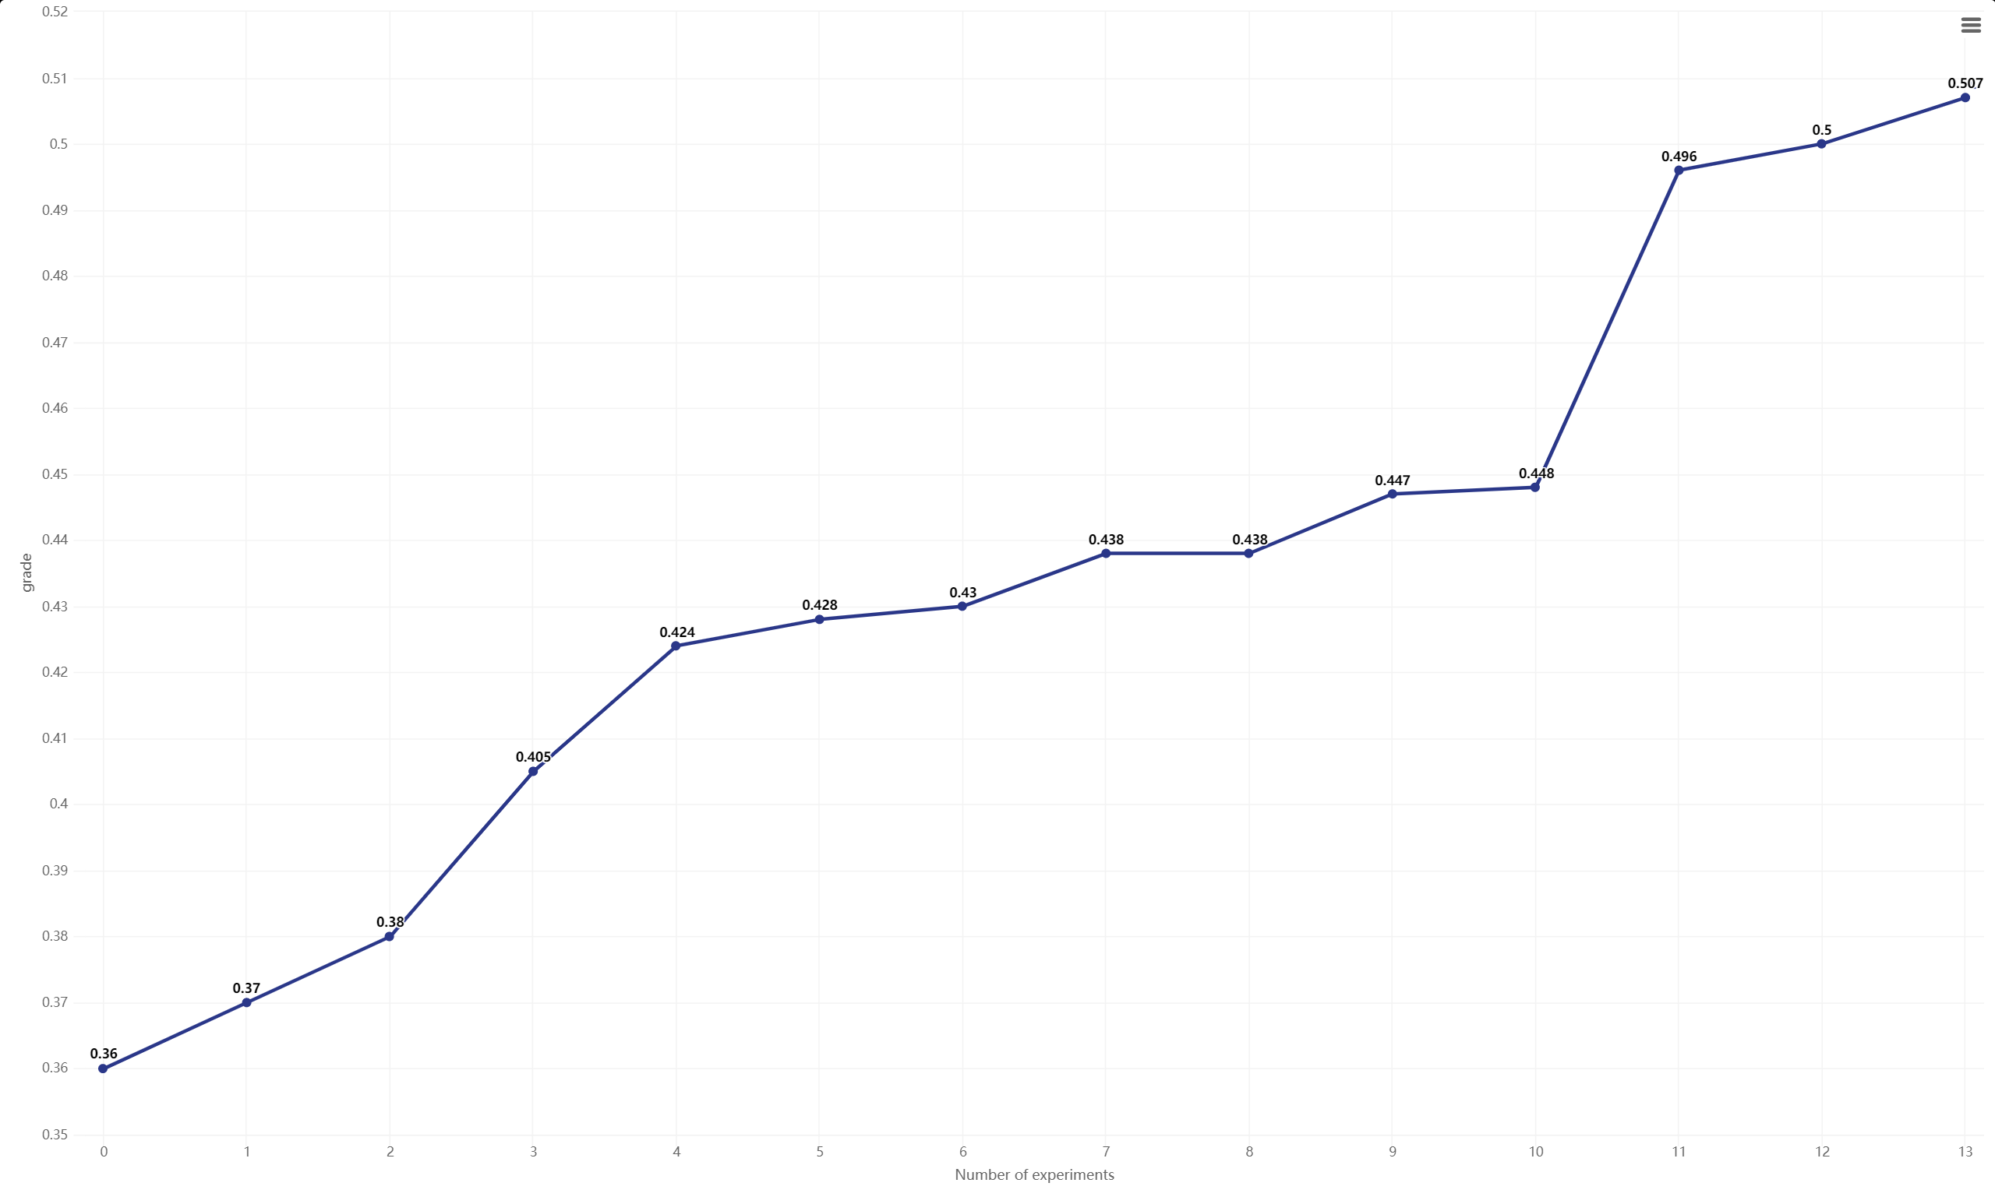

Slide 32
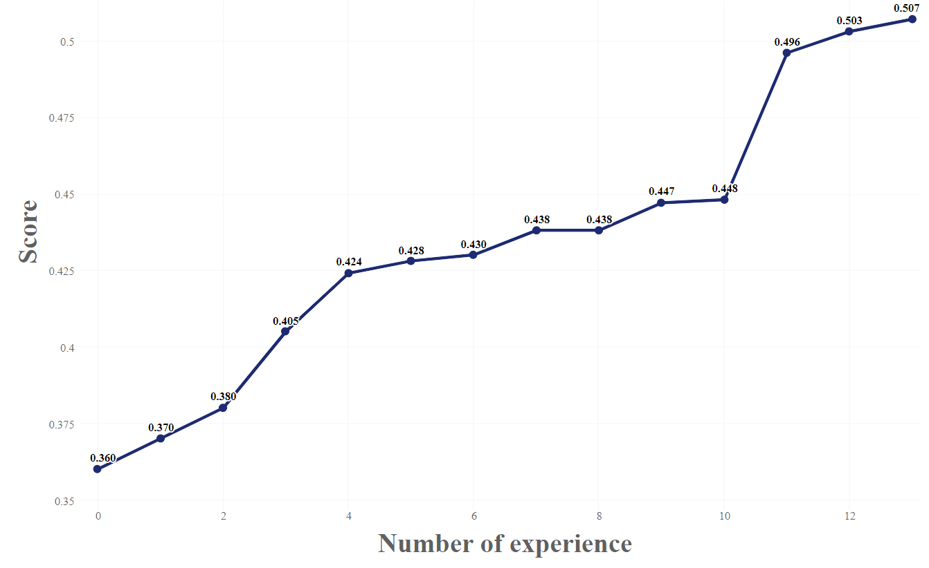
Stage 1
Stage 2
Stage 3

Slide 33
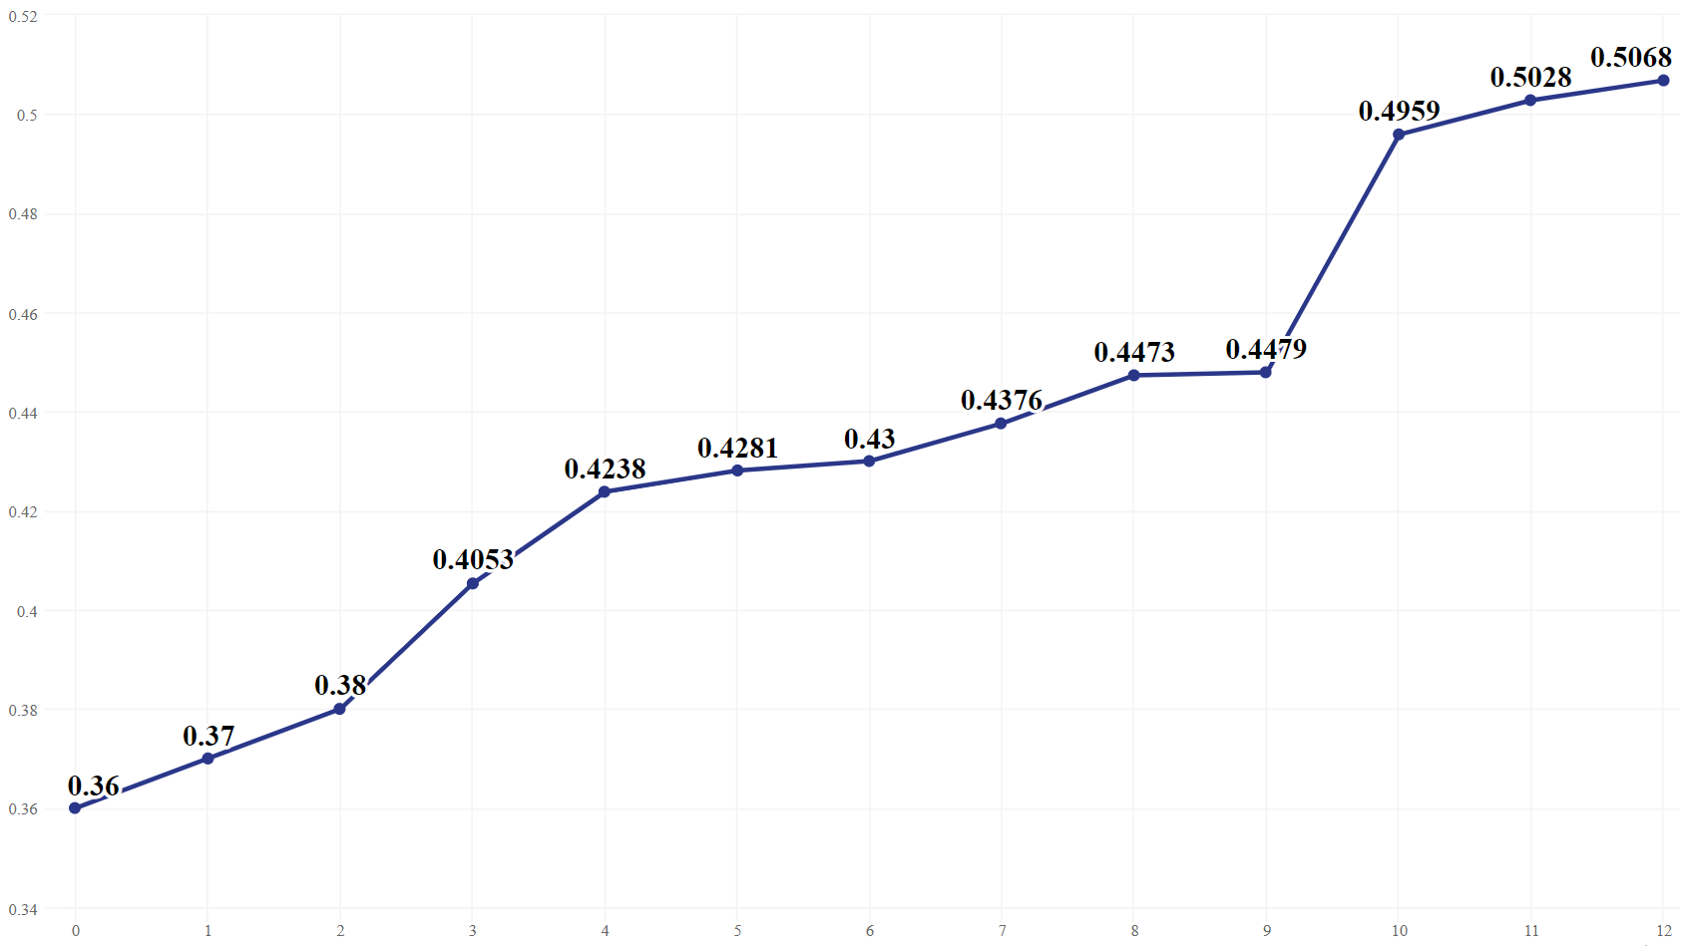
Stage 1
Stage 2
Stage 3

Slide 34
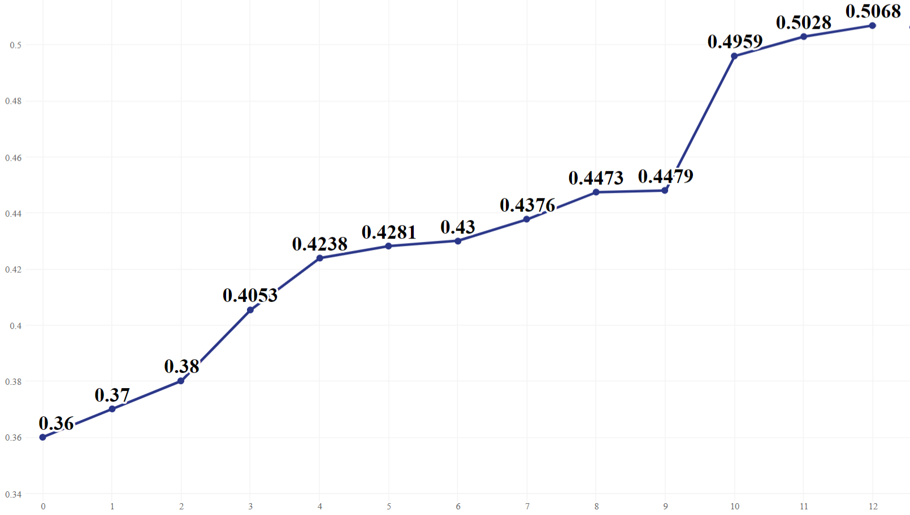
Stage 1
Stage 2
Stage 3

Slide 35
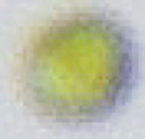
Objective
Reference image
Composite image
Original image

Slide 36
Objective
Reference image
Composite image
Original image

Slide 37
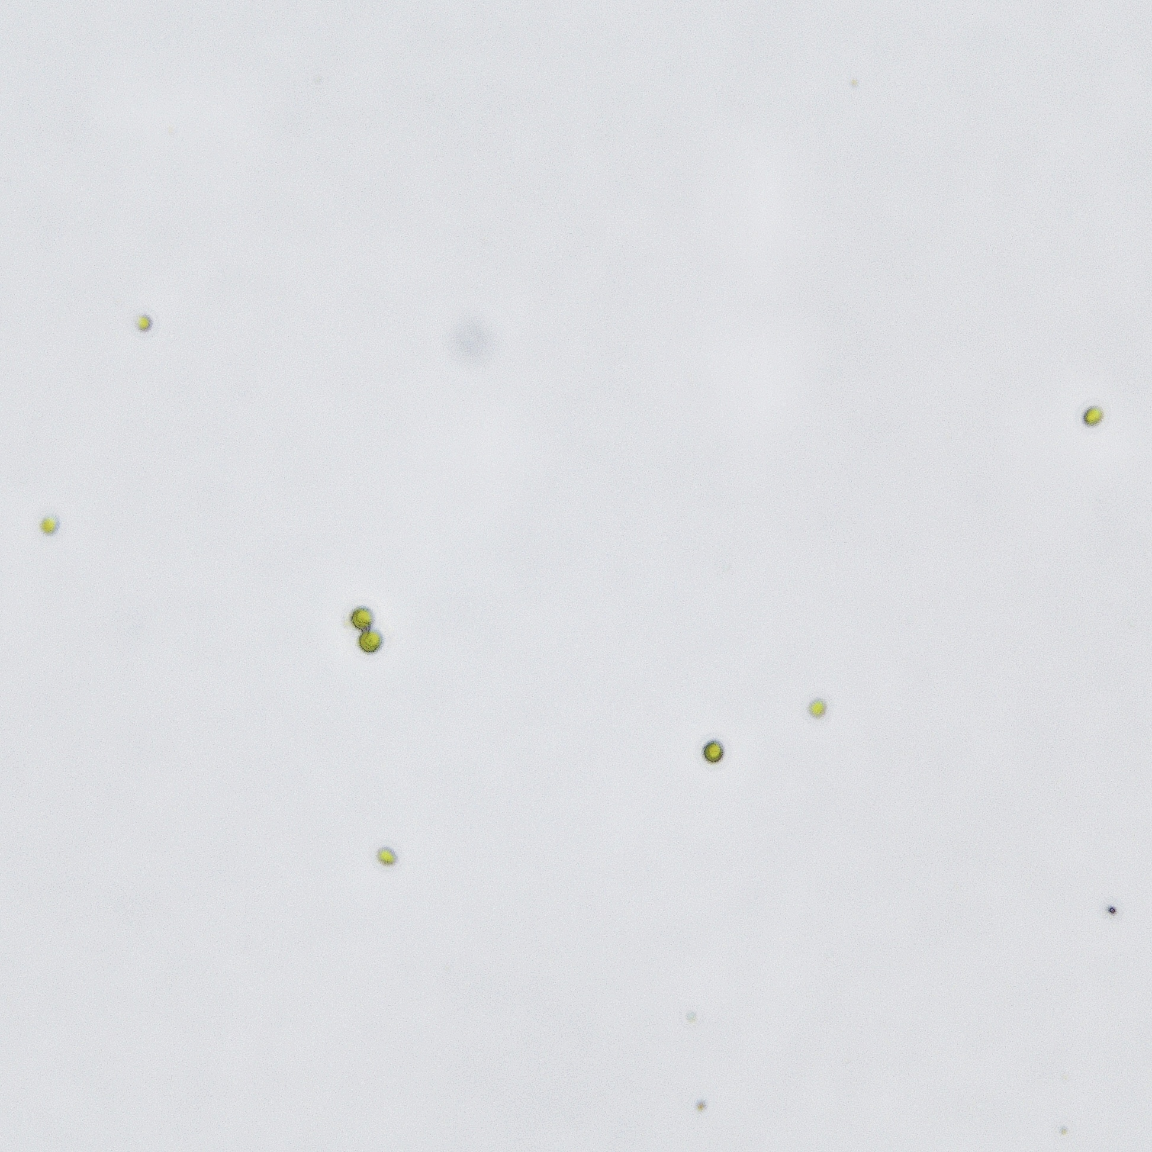
Objective
Reference image
Composite image
Original image

Slide 39
Conv1 3*3 BN/R
MaxPool
Stage2
Repeat 4
Resize
Crop
Flip
Pad
Stage3
Repeat 8
LargeScaleJitting & StandardScaleJitting
Stage4
Repeat 4
Conv5
Resize
Crop
Flip
Pad
FC
LargeScaleJitting & StandardScaleJitting

Slide 40

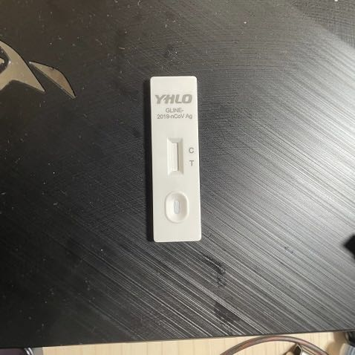
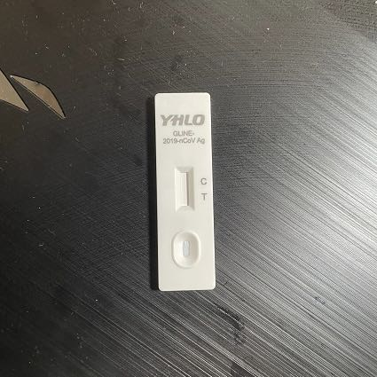
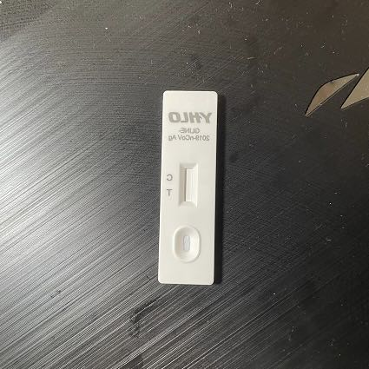
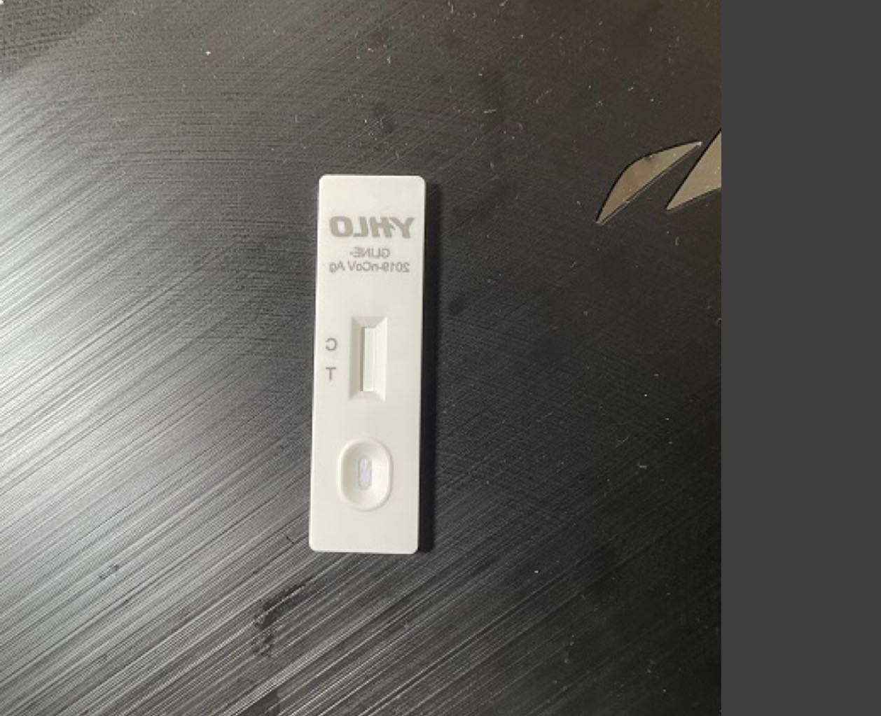
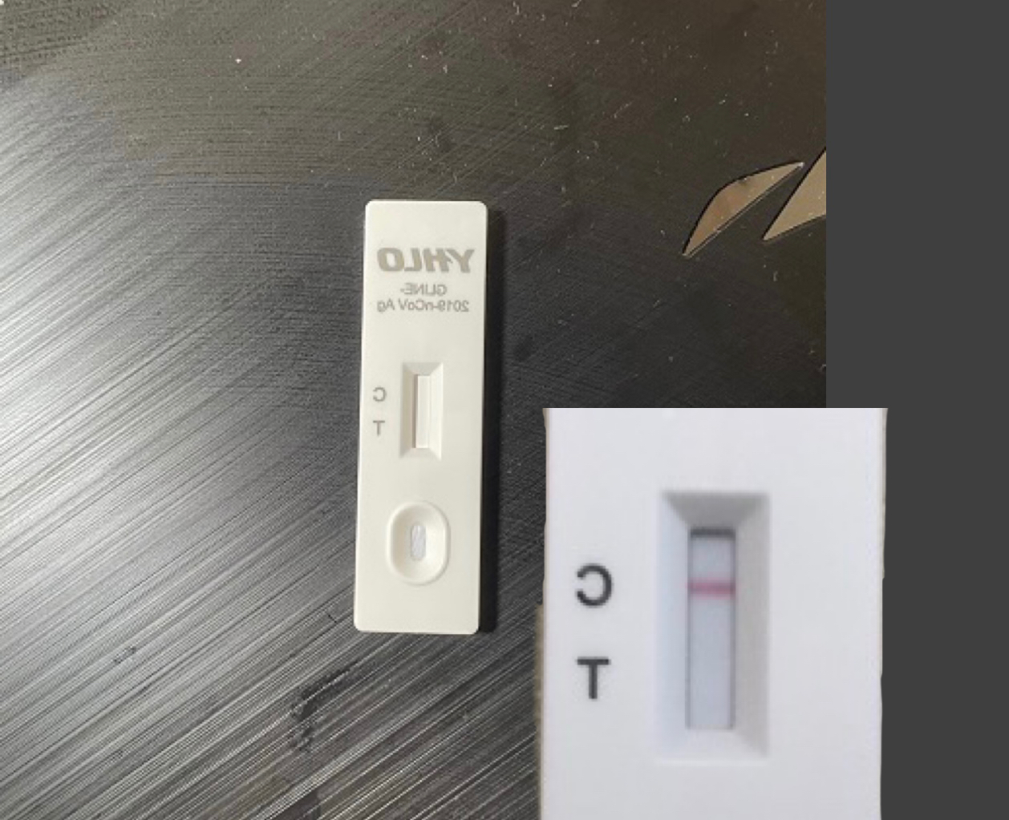
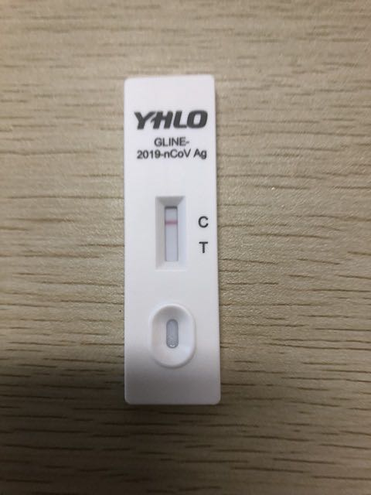
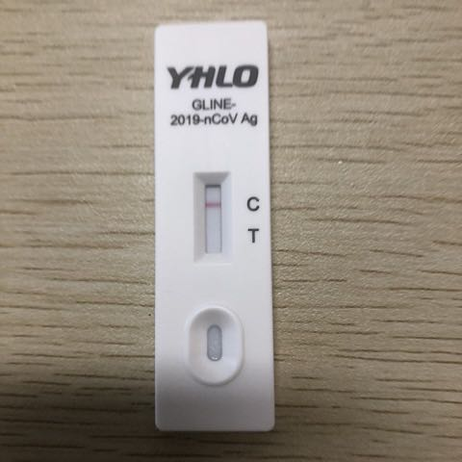
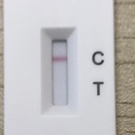
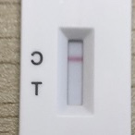
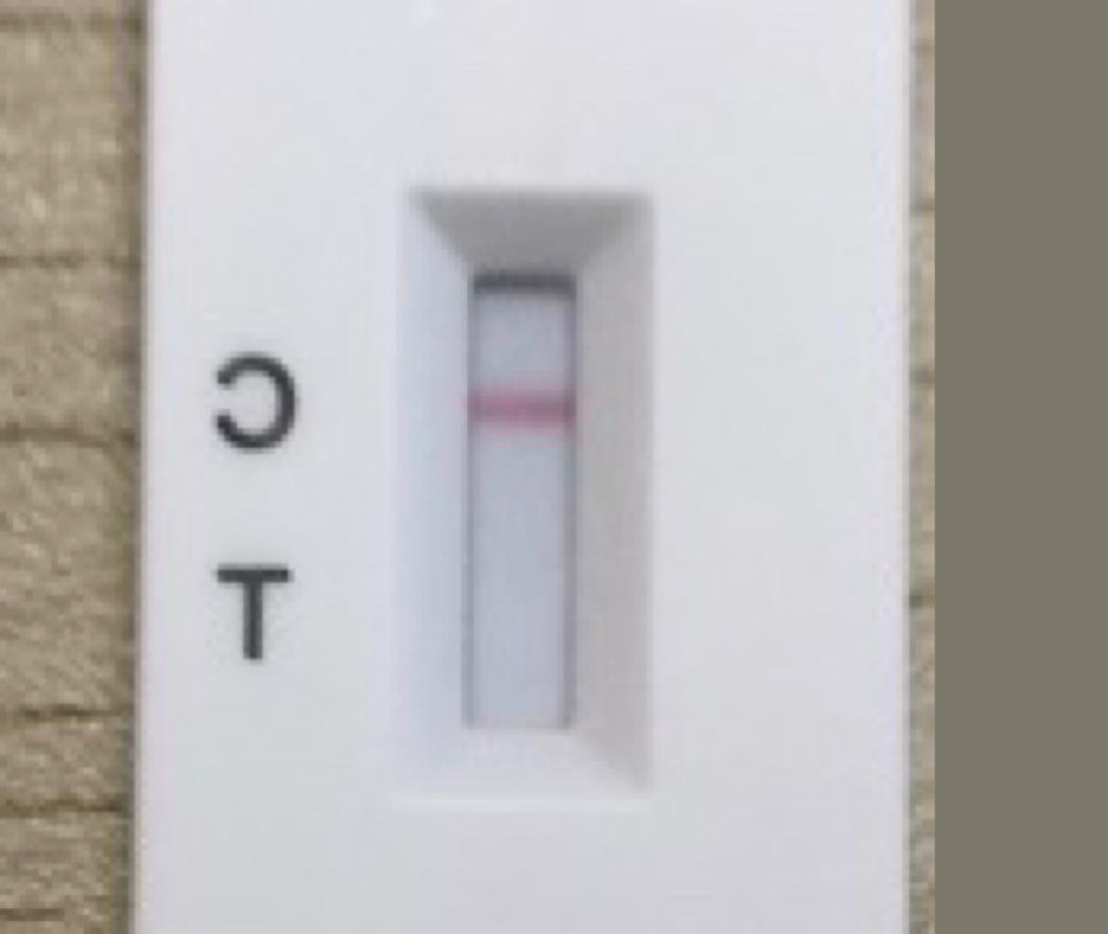
Resize
Crop
Flip
Pad
LargeScaleJitting & StandardScaleJitting
CopyPaste

Slide 41
Resize
Crop
Flip
Pad
LargeScaleJitting & StandardScaleJitting
CopyPaste

Slide 42
Resize
Crop
Flip
Pad
LargeScaleJitting & StandardScaleJitting
CopyPaste

Slide 43
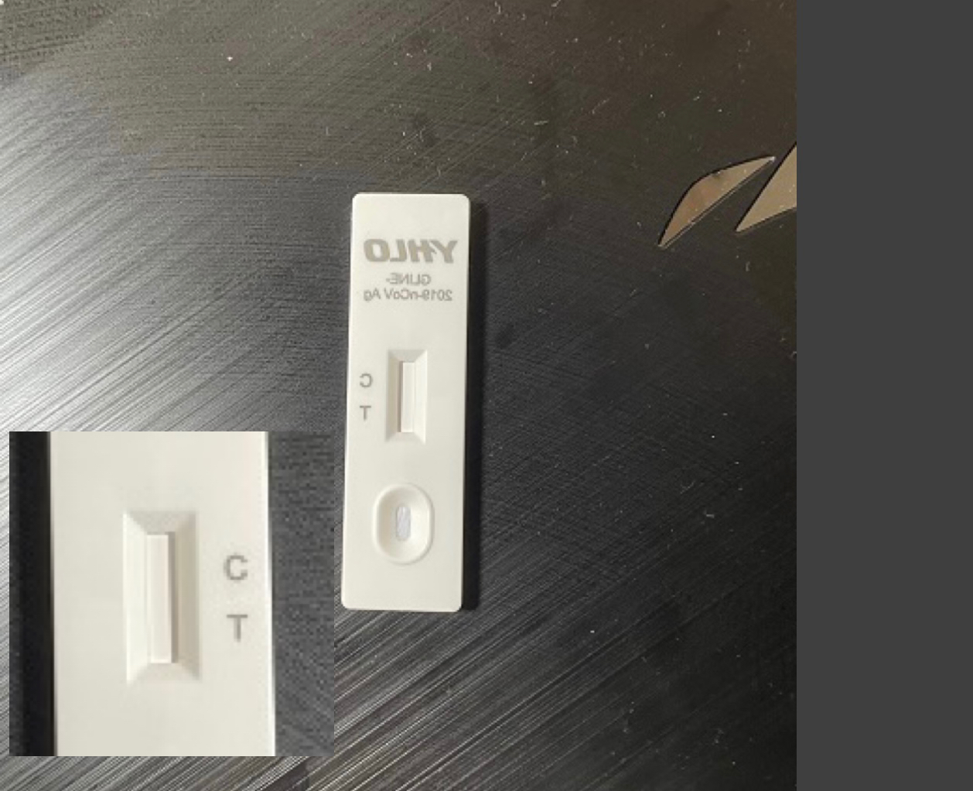
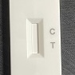
Resize
Crop
Flip
Pad
LargeScaleJitting & StandardScaleJitting
SingleCopyPaste

Slide 44
Resize
Crop
Flip
Pad
LargeScaleJitting & StandardScaleJitting
SingleCopyPaste

Slide 45
Resize
Crop
Flip
Pad
LargeScaleJitting & StandardScaleJitting
CopyPaste

Slide 46
Resize
Crop
Flip
Pad
LargeScaleJitting & StandardScaleJitting
CopyPaste

Slide 47
Conv1 3*3 BN/R
MaxPool
Stage2
Repeat 4
Stage3
Repeat 8
Resize
Crop
Flip
Pad
LargeScaleJitting & StandardScaleJitting
Stage4
Repeat 4
CopyPaste
Conv5
FC
SimpleCopyPaste

Slide 49

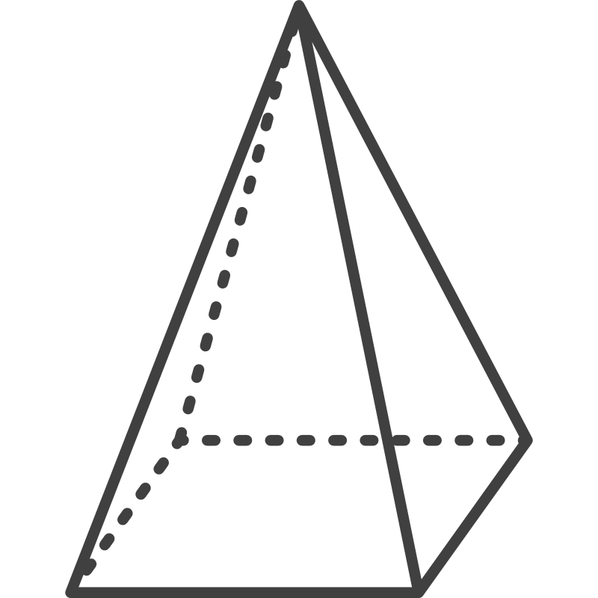



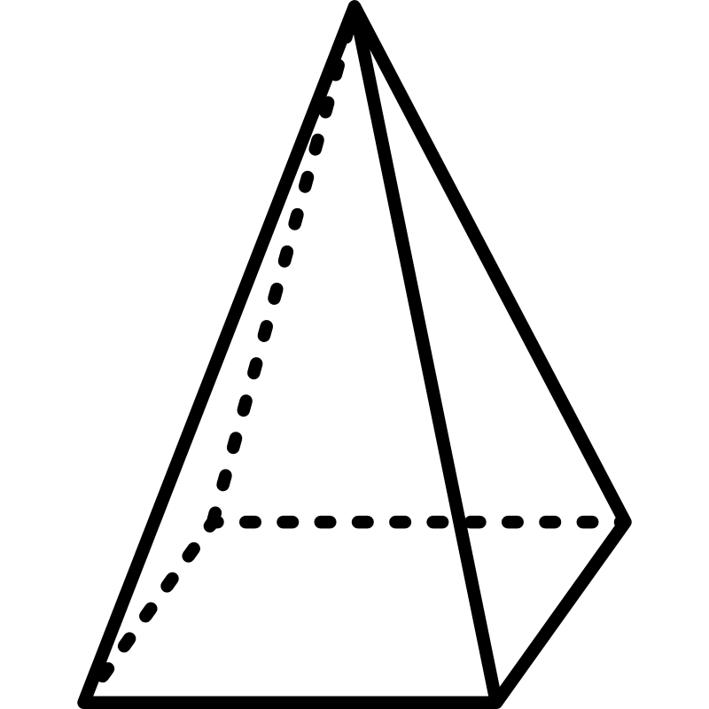


Slide 50
Add & Norm
Feed
Forward
Add & Norm
Multi-Head
Attention
Input
Embedding

Slide 51
Add & Norm
Feed
Forward
Add & Norm
Multi-Head
Attention
Input
Embedding

Slide 52
Add & Norm
Feed
Forward
Add & Norm
Multi-Head
Attention
Input
Embedding

Slide 53
CNN 1
Input:
40 × 282
Dense
Input：
MFC Coefficients
40 × 282
Conv 3×3
Maxpool 2×2
Conv 3×3
Maxpool 4×4
Maxpool 4×4
CNN 2
Input:
40 × 282
Conv 3×3
Add & Norm
Log Softmax
Feed
Forward
Add & Norm
Multi-Head
Attention
Transformer
40×282
Maxpool 1×4
Input
40×70
Input
Embedding

Slide 54
CNN 1
Input:
40 × 282
Dense
Input：
MFC Coefficients
40 × 282
Conv 3×3
Maxpool 2×2
Conv 3×3
Maxpool 4×4
Maxpool 4×4
CNN 2
Input:
40 × 282
Conv 3×3
Add & Norm
Log Softmax
Feed
Forward
Add & Norm
Multi-Head
Attention
Transformer
40×282
Maxpool 1×4
Input
40×70
Input
Embedding

Slide 55
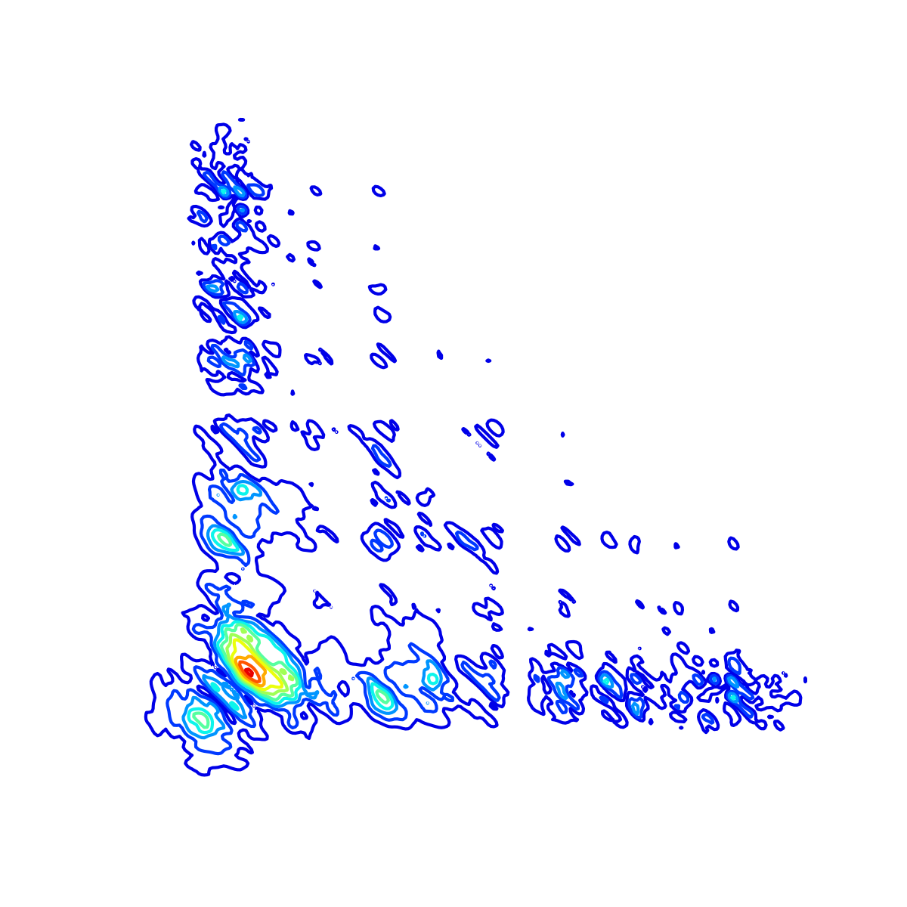
256
256
CNN 1
Input:
256 × 256
128
128
FC
32
32
256
256
128
Input：
256 × 256
128
32
32
8
1
16
16
8
32
32
64
64
Conv 3×3
Maxpool 2×2
Conv 3×3
Maxpool 4×4
Maxpool 4×4
CNN 2
Input:
256 × 256
256
Conv 3×3
256
128
128
1×256
32
Add & Norm
Softmax
256
256
32
Feed
Forward
128
4 ×
Transformer
Encoder
128
32
32
8
1
8
Add & Norm
16
16
32
32
64
32
Multi-Head
Attention
Transformer
Parallel Transformer-CNN Model
256×256
Maxpool 1×4
Input
256×64
Input
Embedding
4 Attention Heads Per Encoder

Slide 56
Add & Norm
Feed
Forward
Add & Norm
Multi-Head
Attention
Input
Embedding
Inputs

Slide 57
Conv1 3*3 BN/R
MaxPool
Stage2
Repeat 4
Stage3
Repeat 8
Resize
Crop
Flip
Pad
LargeScaleJitting & StandardScaleJitting
Stage4
Repeat 4
CopyPaste
Conv5
FC
SimpleCopyPaste

Slide 58
3*224*224
Subsampling/
Ascending Dimension
Conv1 3*3 BN/R
General Module
24*112*122
General Module
MaxPool
General Module
24*56*56
Subsampling/
Ascending Dimension
Stage2
Repeat 4
General Module
General Module
116*28*28
General Module
Stage3
Repeat 8
General Module
General Module
General Module
232*14*14
General Module
Stage4
Repeat 4
Subsampling/
Ascending Dimension
464*7*7
General Module
General Module
General Module

Slide 59
3*224*224
Subsampling/
Ascending Dimension
Conv1 3*3 BN/R
General Module
24*112*122
General Module
MaxPool
General Module
24*56*56
Subsampling/
Ascending Dimension
Stage2
Repeat 4
General Module
General Module
116*28*28
General Module
Stage3
Repeat 8
General Module
General Module
General Module
232*14*14
General Module
Stage4
Repeat 4
Subsampling/
Ascending Dimension
General Module
464*7*7
General Module
Conv5
1024*7*7
General Module
FC

Slide 60
3*224*224
Subsampling/
Ascending Dimension
Conv1 3*3 BN/R
General Module
24*112*122
General Module
MaxPool
General Module
24*56*56
Subsampling/
Ascending Dimension
Stage2
Repeat 4
General Module
General Module
116*28*28
General Module
Stage3
Repeat 8
General Module
General Module
General Module
232*14*14
Stage4
Repeat 4
General Module
Subsampling/
Ascending Dimension
464*7*7
General Module
General Module
General Module

Slide 61
3*224*224
Subsampling/
Ascending Dimension
Conv1 3*3 BN/R
General Module
24*112*122
General Module
MaxPool
General Module
24*56*56
Subsampling/
Ascending Dimension
Stage2
Repeat 4
General Module
General Module
116*28*28
General Module
Stage3
Repeat 8
General Module
General Module
General Module
232*14*14
General Module
Stage4
Repeat 4
Subsampling/
Ascending Dimension
General Module
464*7*7
General Module
Conv5
1024*7*7
General Module
FC

Slide 62
3*224*224
Subsampling/
Ascending Dimension
Conv1 3*3 BN/R
General Module
24*112*122
General Module
MaxPool
General Module
24*56*56
Subsampling/
Ascending Dimension
Stage2
Repeat 4
General Module
General Module
116*28*28
General Module
Stage3
Repeat 8
General Module
General Module
General Module
232*14*14
General Module
Stage4
Repeat 4
Subsampling/
Ascending Dimension
464*7*7
General Module
General Module
General Module

Slide 63
Subsampling/
Ascending Dimension
3*224*224
General Module
Conv1 3*3 BN/R
24*112*122
General Module
MaxPool
General Module
24*56*56
Subsampling/
Ascending Dimension
Stage2
Repeat 4
General Module
General Module
116*28*28
General Module
Stage3
Repeat 8
General Module
General Module
General Module
232*14*14
Stage4
Repeat 4
General Module
Subsampling/
Ascending Dimension
464*7*7
General Module
General Module
General Module

Slide 64
3*224*224
3*224*224
Conv1 3*3 BN/R
Conv1 3*3 BN/R
24*112*122
24*112*122
MaxPool
MaxPool
24*56*56
24*56*56
Stage2
Repeat 4
Stage2
Repeat 4
116*28*28
116*28*28
Stage3
Repeat 8
Stage3
Repeat 8
232*14*14
232*14*14
Stage4
Repeat 4
Stage4
Repeat 4
464*7*7
464*7*7
Conv5
1024*7*7
FC

Slide 65
3*224*224
3*224*224
Conv1 3*3 BN/R
Conv1 3*3 BN/R
24*112*122
24*112*122
MaxPool
MaxPool
24*56*56
24*56*56
Stage2
Repeat 4
Stage2
Repeat 4
116*28*28
116*28*28
Stage3
Repeat 8
Stage3
Repeat 8
232*14*14
232*14*14
Stage4
Repeat 4
Stage4
Repeat 4
464*7*7
464*7*7
Conv5
1024*7*7
FC

Slide 66
Subsampling/
Ascending Dimension
3*224*224
General Module
Conv1 3*3 BN/R
24*112*122
General Module
MaxPool
General Module
24*56*56
Subsampling/
Ascending Dimension
Stage2
Repeat 4
General Module
General Module
116*28*28
General Module
Stage3
Repeat 8
General Module
General Module
General Module
232*14*14
Stage4
Repeat 4
General Module
Subsampling/
Ascending Dimension
464*7*7
General Module
Conv5
General Module
1024*7*7
General Module
FC

Slide 67
Conv
Ground Truth
Localization
Classification
DWConv
Concat
Self-trained Classifier
Model Ensemble
Prediction
NMS
Localization
ResNet18
WBF
Classification

Slide 68
Conv
DWConv
Concat
Shuffle

Slide 69
Subsampling/
Ascending Dimension
3*224*224
General Module
Conv1 3*3 BN/R
24*112*122
General Module
MaxPool
General Module
24*56*56
Subsampling/
Ascending Dimension
Stage2
Repeat 4
General Module
General Module
116*28*28
General Module
Stage3
Repeat 8
General Module
General Module
General Module
232*14*14
Stage4
Repeat 4
General Module
Subsampling/
Ascending Dimension
464*7*7
General Module
General Module
General Module

Slide 70
Subsampling/
Ascending Dimension
3*224*224
General Module
Conv1 3*3 BN/R
24*112*122
General Module
MaxPool
General Module
24*56*56
Subsampling/
Ascending Dimension
Stage2
Repeat 4
General Module
General Module
116*28*28
General Module
Stage3
Repeat 8
General Module
General Module
General Module
232*14*14
Stage4
Repeat 4
General Module
Subsampling/
Ascending Dimension
464*7*7
General Module
Conv5
General Module
1024*7*7
General Module
FC

Slide 71
BackBone
ShuffleBlock
Conv2d BN/ReLu
1x1 Conv
BN/ReLU
3x3 DWConv
BN
1x1 Conv
BN/ReLU
Concat
Channle Shuffle
MaxPool
3x3 DWConv
BN
1x1 Conv
BN/ReLU
ShuffleBlock
Neck
Head
ShuffleBlock
Concat + DWConv
Detect
ShuffleBlock
GSConv + CARAFE
DownSampling
ShuffleBlock
Concat + DWConv
ADD + DWConv
ShuffleBlock
GSConv + CARAFE
DownSampling
Detect
ShuffleBlock
ADD + DWConv
NAM
Detect

Slide 72
BackBone
(L-ShufflenetV2)
Shuffle_Block
Conv2d BN/ReLu
Conv_BN_Mish
CSPBottleneck
Concat
Conv_BN_Mish
MaxPool
Conv_BN_Mish
Shuffle-Block
Light-Neck
Head
Shuffle-Block
Concat + DW
Detect
Shuffle-Block
GSConv + CARAFE
DownSampling
Shuffle-Block
Concat + DW
ADD + DW
Detect
Shuffle-Block
Shuffle-Block
GSConv + CARAFE
DownSampling
SPPF
ADD + DW
SepVit Block * 3
NAM
Detect

Slide 73

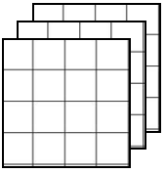
3 channel Input Filters * 4 Maps * 4
NxN
NxN

Slide 74
standard convolution
3 channel Input Filters * 3 Maps * 3
NxN
NxN

Slide 75
standard convolution (SC)
3 channel Input Filters * 4 Maps * 4
NxN
NxN
depth-wise convolution (DWConv)
3 channel Input Filters * 3 Maps * 3
NxN
NxN

Slide 76

standard convolution (SC)
depth-wise convolution (DWConv)
3 channel Input Filters * 4 Maps * 4
3 channel Input Filters * 3 Maps * 3
NxN
NxN
NxN
NxN

Slide 77
C2/2 channels
Conv
input
C1 channels
DWConv
Concat
Shuffle
output
C2 channels
C2/2 channels

Slide 78
(x3, y3)
w
(x1, y1)
h
(x, y)
(x4, y4)
a
(x2, y2)

